Slide 1

opening a Lebanese restaurant in Los Angeles, US
By Abbass Hammoud

Slide 2
Problem description and background
Fadi, a Lebanese-American, is aiming to open a new Lebanese restaurant in Los Angeles
He doesn’t know which neighborhood he should pick for the location of his restaurant, in order to maximize his success and eventually his potential revenues
So he calls our data consulting firm to help him figure out the best neighborhoods, and avoid the less attractive ones.

Slide 3
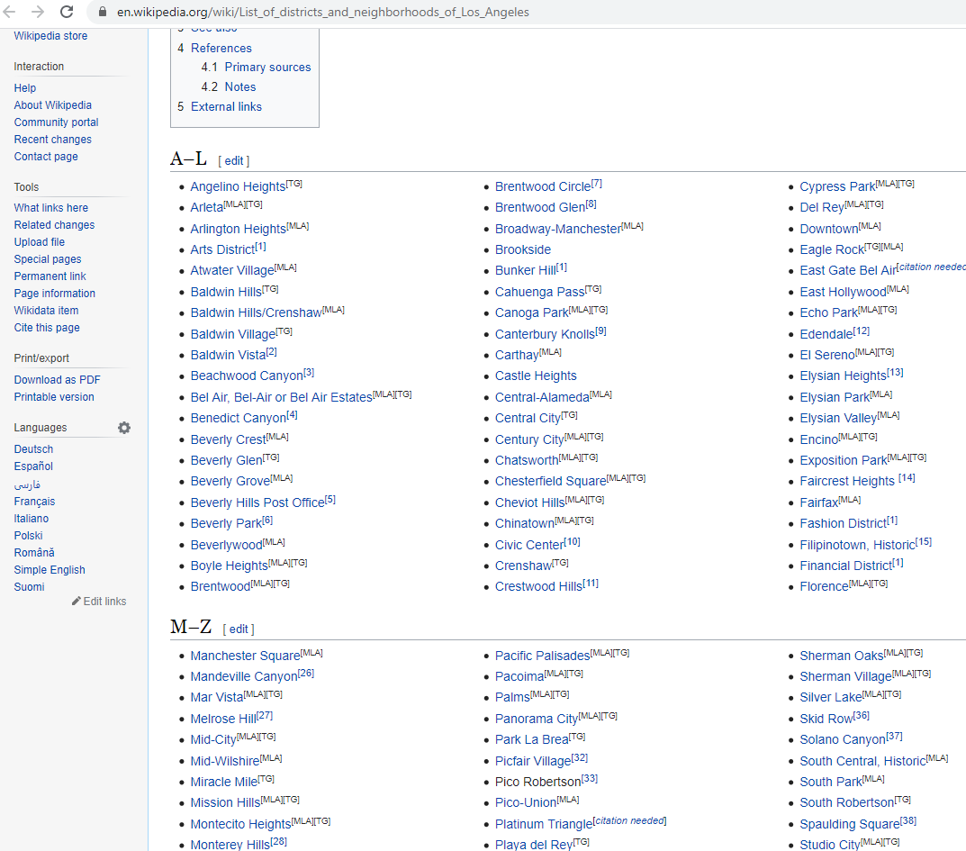
Data acquisition
To get the data for our study we use the Wikipedia page for the list of neighborhoods:
https://en.wikipedia.org/wiki/List_of_districts_and_neighborhoods_of_Los_Angeles

Slide 4
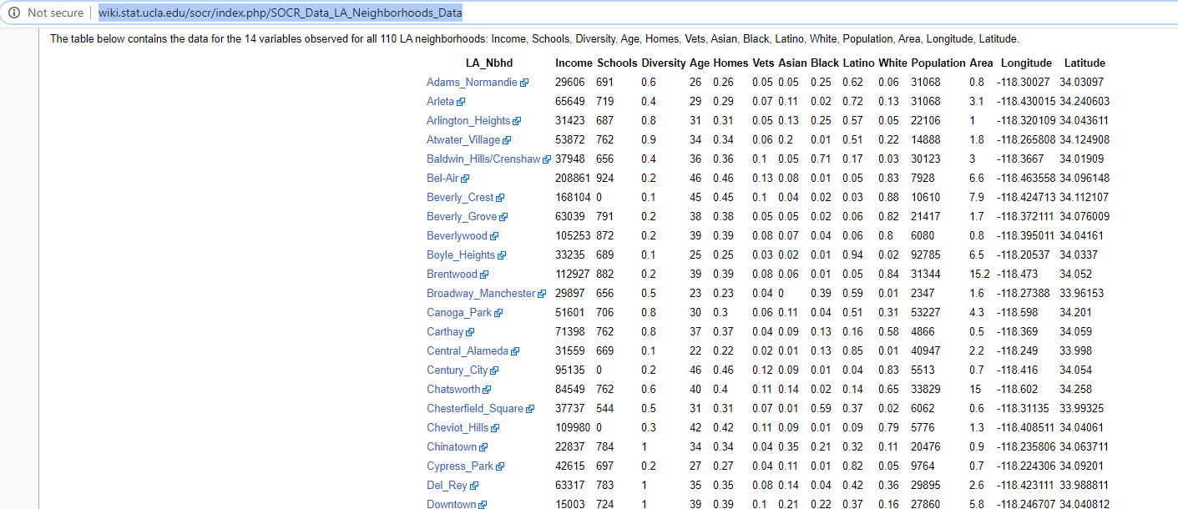
Data acquisition
We use this page for the population and area of the neighborhoods:
http://wiki.stat.ucla.edu/socr/index.php/SOCR_Data_LA_Neighborhoods_Data

Slide 5
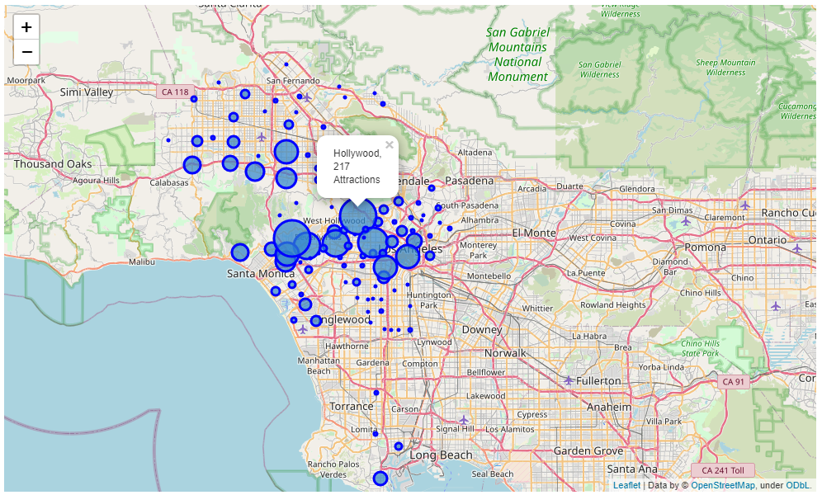
Data acquisition
And foursquare library for location data

Slide 6
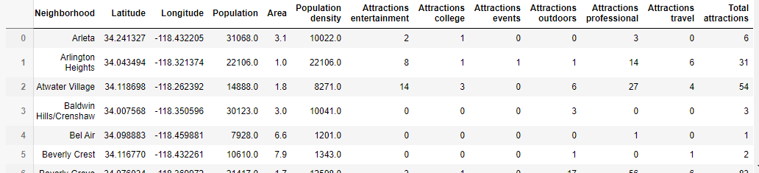
Data acquisition
And here is the dataframe for processing

Slide 7
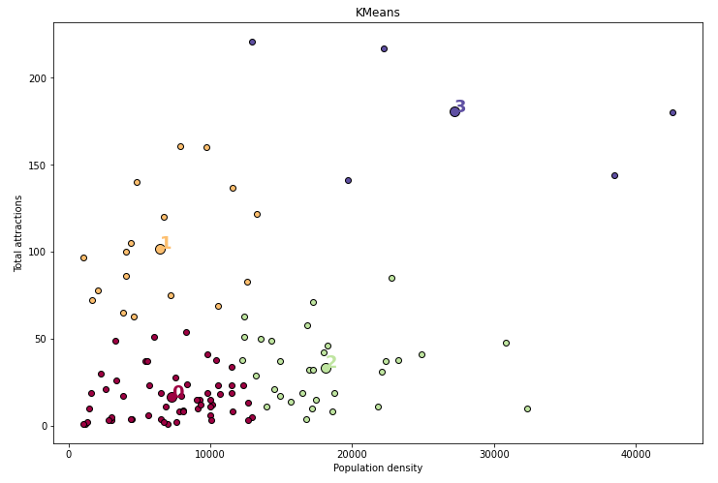
Machine learning methodology
We use k-means for clustering the neighborhoods
Number of clusters = 4

Slide 8
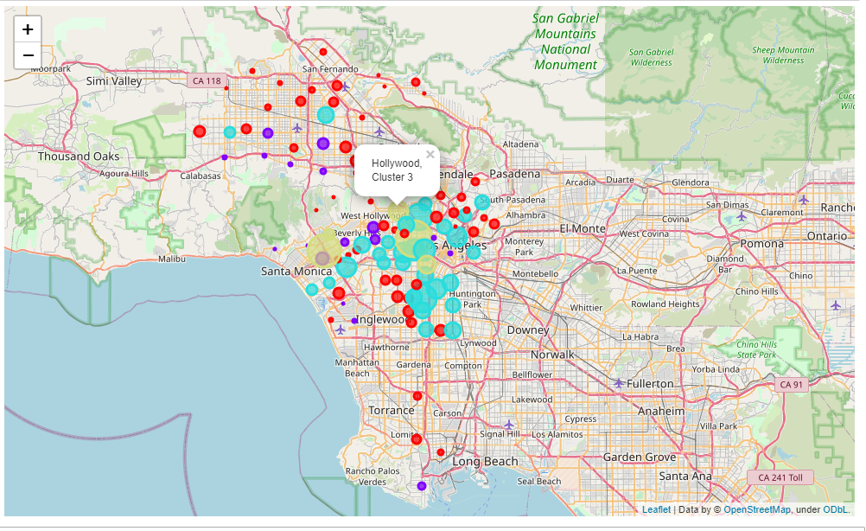
Neighborhoods clustering

Slide 9
Neighborhoods clustering
Cluster 0: contains the neighborhoods with low population density and low number of attractions
Cluster 1: contains the neighborhoods with high number of attractions but relatively low population density
Cluster 2: contains the neighborhoods with high population density but relatively low number of attractions
Cluster 3: contains the neighborhoods with high population density and high number of attractions

Slide 10
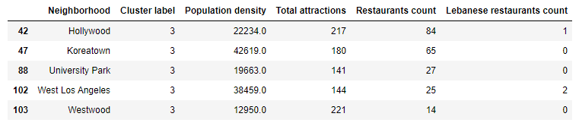
Best neighborhoods

Slide 11
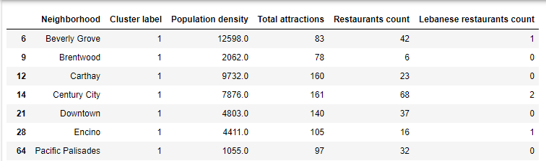
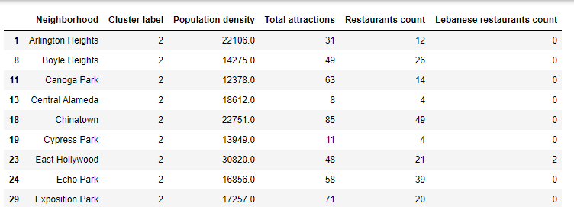
Runners-up

Slide 12
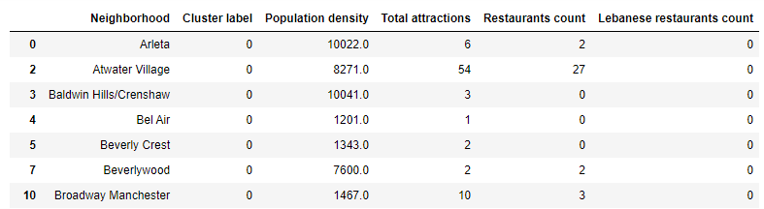
Least attractive neighborhoods

